Slide 1
LENDING CLUB CASE STUDY Final Submission
Case Study Group:
Ramya Sree
Suraj Chowrasia(Group facilitator)

Slide 2
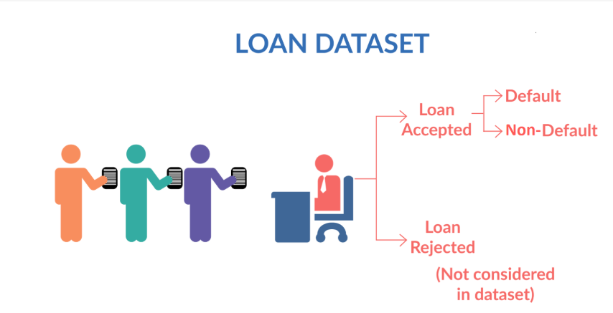
Problem Statement :
You work for a consumer finance company which specializes in lending various types of loans to urban customers. When the company receives a loan application, the company has to make a decision for loan approval based on the applicant’s profile. Two types of risks are associated with the bank’s decision:
If the applicant is likely to repay the loan, then not approving the loan results in a loss of business to the company.
If the applicant is not likely to repay the loan, i.e. he/she is likely to default, then approving the loan may lead to a financial loss for the company
The data given below contains the information about past loan applicants and whether they ‘defaulted’ or not.
The aim is to identify patterns which indicate if a person is likely to default, which may be used for taking actions such as denying the loan, reducing the amount of loan, lending (to risky applicants) at a higher interest rate, etc.

Slide 3
Overall Approach of the Analysis :
Like most other lending companies, lending loans to ‘risky’ applicants is the largest source of financial loss (called credit loss).
If one is able to identify these risky loan applicants, then such loans can be reduced thereby cutting down the amount of credit loss. Identification of such applicants using EDA is the aim of this case study.
Business Understanding & Data Exploration
Formatting Data
Perform Multivariate Analysis
Summary & Suggestions
Perform Bivariate Analysis
Perform Univariate Analysis
Removing Outliers
Cleaning Data

Slide 4
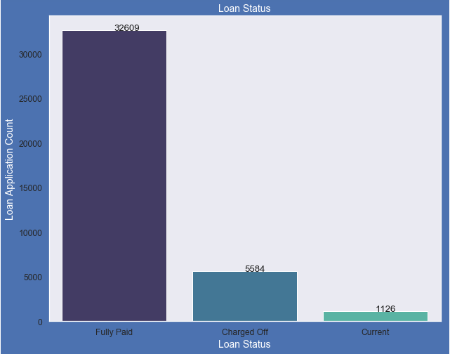
Plot and Data shows that :
14% loans were charged off out of total loan issued.
83% loans were fully paid out of total loan issued.
Fully Paid 83.57 %
Charged Off 14.08 %
Current 02.57 %
Lets analyze the loan status those who are charged off due to various other factors

Slide 5
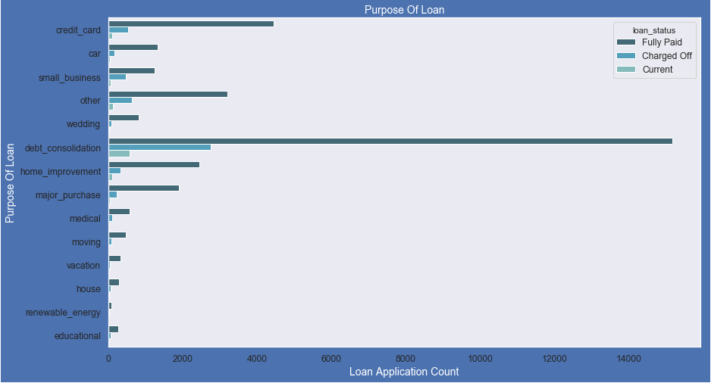
Purpose of Loans:
Purpose of Loans:
Most of the loans were taken for the purpose of debt consolidation & paying credit card bill.
Number of charged off count also high too for these loans.
Loan Purpose Percentage:
debt_consolidation 46.87%
credit_card 12.75%
other 10.03%
home_improvement 7.35%
major_purchase 5.35%
small_business 4.52%

Slide 6
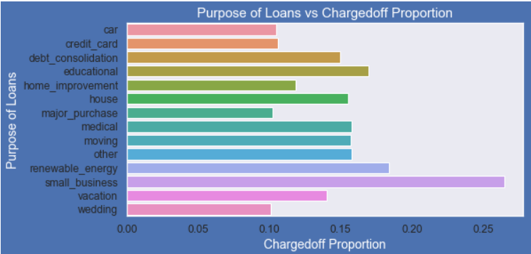
Purpose of Loans v/s Loan charged off Proportion :
Small Business applicants have high chances of getting charged off.
Renewable energy & Educational purpose have changed off proportion high as compare to other categories.

Slide 7
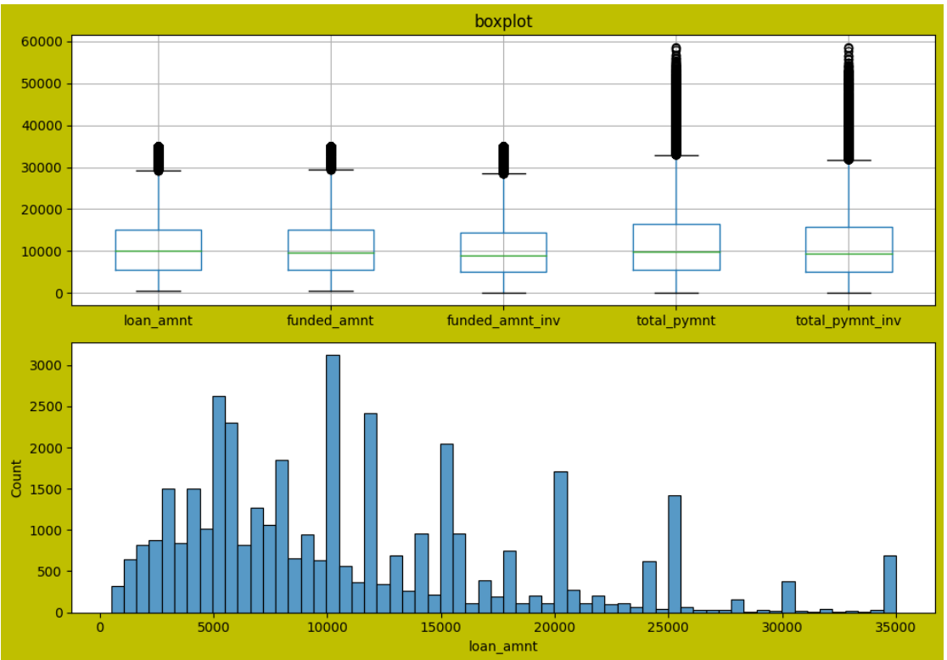

Slide 8
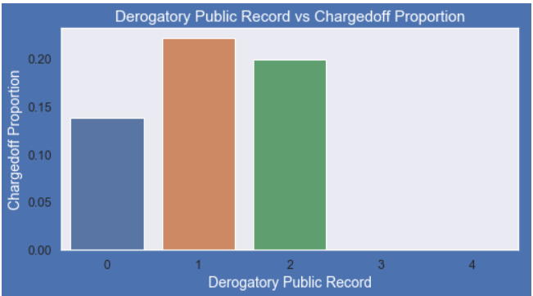
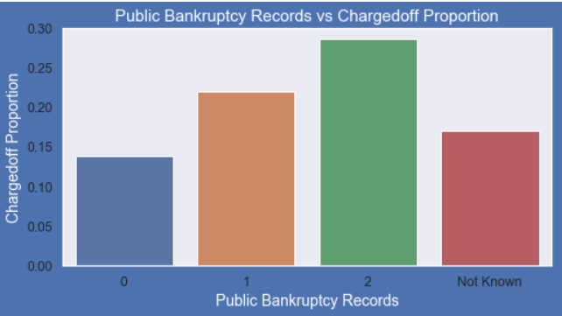
Derogatory Record v/s Loan charged off Proportion :
A derogatory item is an entry that may be considered negative by lenders because it indicates risk and hurts your ability to qualify for credit or other services.
Those who already have Derogatory Public Record value as 1 or 2 have higher charged off chances than others.
Bankruptcy Records v/s Loan charged off Proportion :
Higher the public bankruptcy record greater
the Charged Off proportion.
Not known is the column for which we don't have any information about borrower.

Slide 9
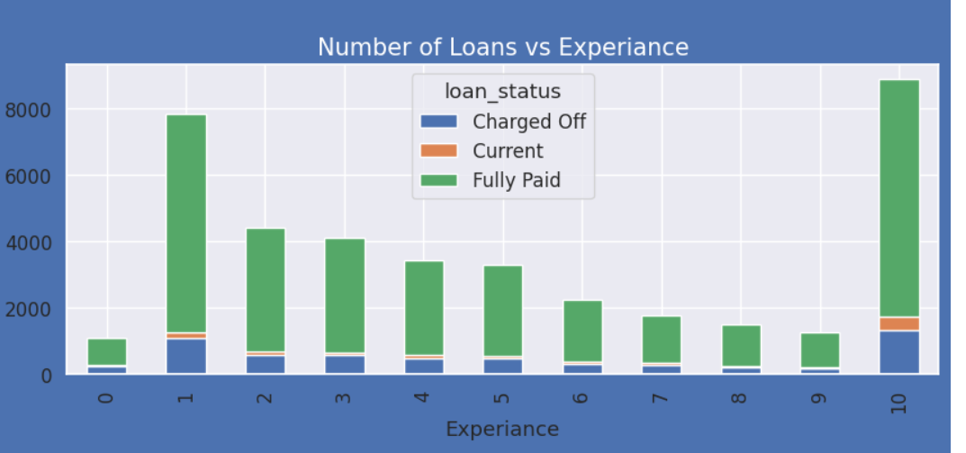

Slide 10
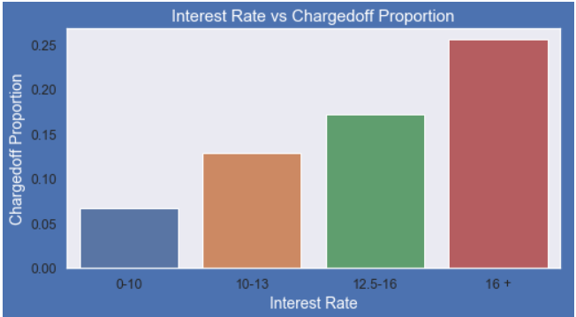
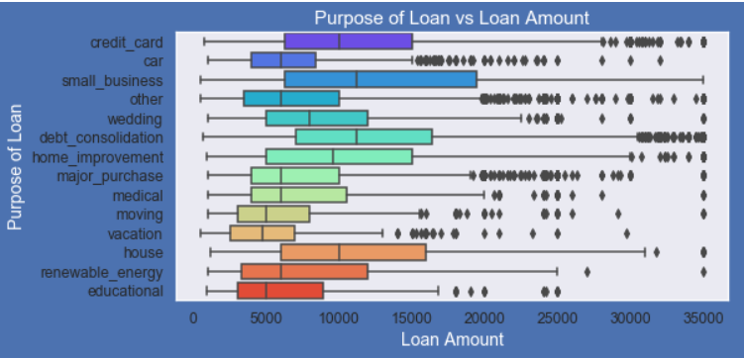
Interest Rate v/s Loan charged off Proportion:
Interest rate more than 16% has good chances of charged off as compared to other category interest rates.
Charged off proportion increases when interest rate increases.
Purpose of Loan v/s Amount applied for Loan:
Most of the loan amounts are big for small business purpose among all purposes.
While the Debt consolidation is second and Credit card is third.

Slide 11
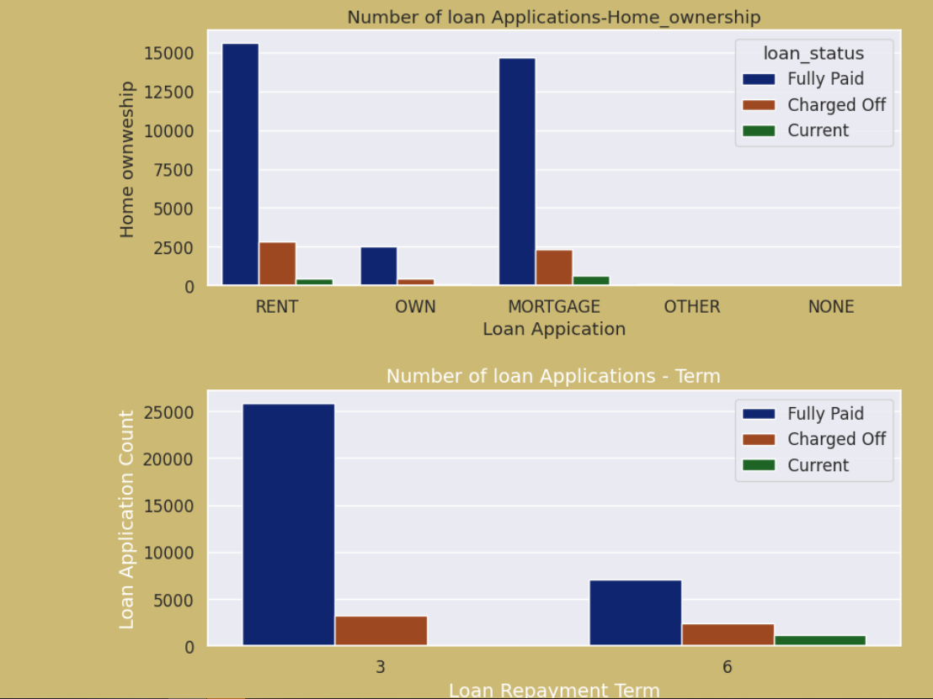

Slide 12
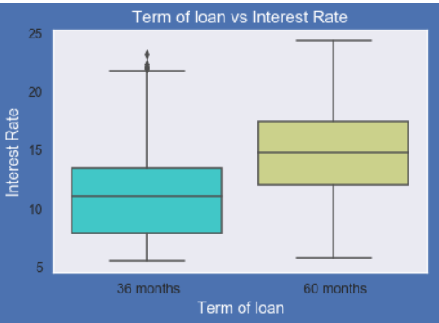
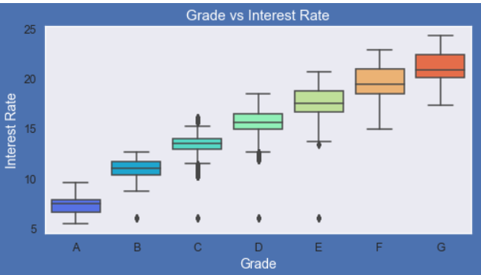
Grades v/s Interest Rate:
A-grade is a top letter grade for a lender to assign to a borrower.
The higher the borrower's credit grade, the lower the interest rate offered to that borrower on a loan.
It is clear that interest rate is increasing with grades moving from A to F.
Term of Loan v/s Interest Rate:
It is clear that average interest rate is higher for 60 months loan term.
Most of the loans issued for longer term had higher interest rates for repayment.

Slide 13
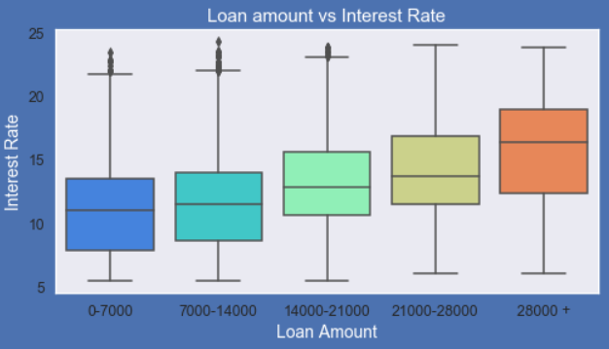
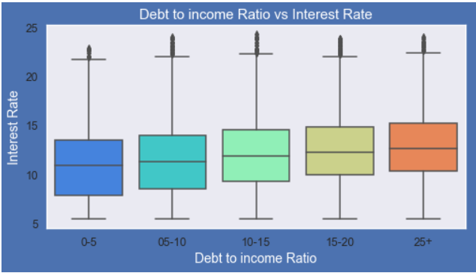
Loan Amount v/s Interest Rate:
It is clear that interest rate is increasing with loan amount increase.
Probably when loan amount is more, it is taken for longer loan term, we saw earlier that longer the loan term more the interest rate.
Debt to Income (DTI) v/s Interest Rate:
If your DTI is low enough you may get a lower interest rate.
Plot shows no significant variation but there is slight increase in interest rate with increase in DTI.

Slide 14
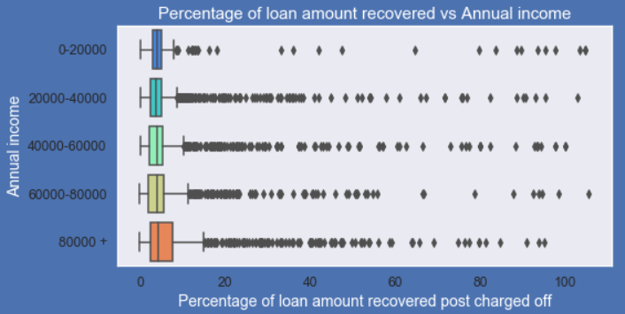
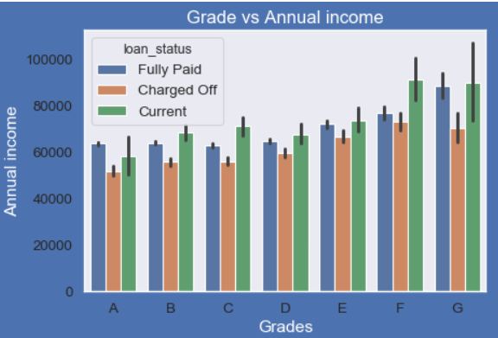
Loan Amount Recovered v/s Annual Income:
Higher percentage of loan amount is recovered when annual income is high.
Plot shows no significant variation but there is slight increase in recovery percentage with increase in annual income.
Grade v/s Applicant’s Annual Income:
From this we can conclude that the ones getting charged for delayed or no repayment of loan have lower annual incomes than the ones who has fully paid for each and every grade (i.e. at same interest range).

Slide 15
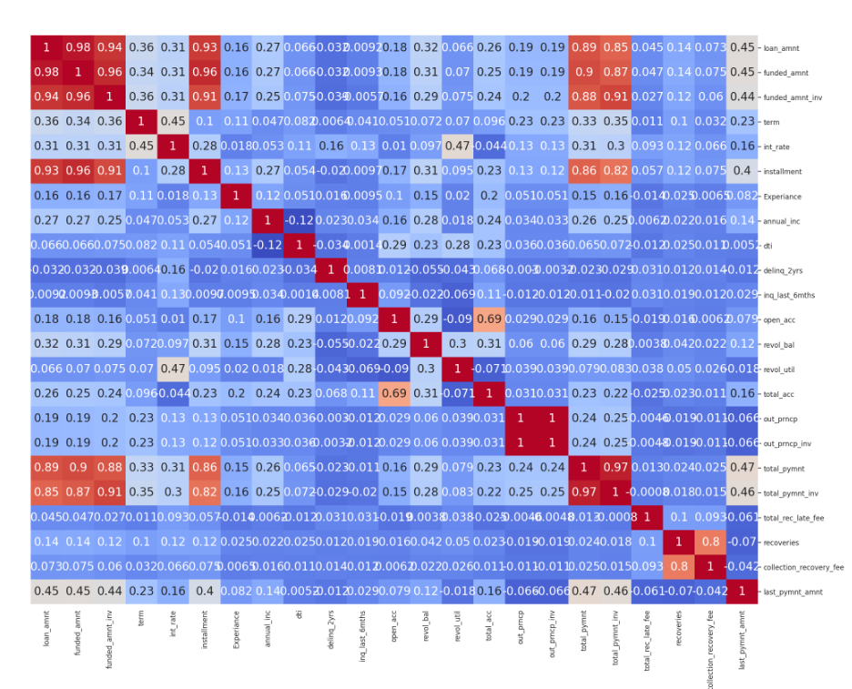
Observations from the matrix
Annual income and DTI debt to income ratio are negatively correlated
So if Annual income is less more debt is owed to the bank.
If loan amount incrases, number of installments also increases
Annual income positively correlated with ecperience.
Outstanding principal out_prncp positively correlated with loan_amnt
loan_amnt and last_pymnt_amnt negatively correlated

Slide 16
Summary & Suggestions:
Based on the Analysis done on the Variables, we conclude the below mentioned points :-
Small Business Applicants have high chances of getting charged off.
Charged off proportion increases with grades moving from “A” towards “G”.
Charged off proportion increases as Interest Rate Increases.
Higher the public bankruptcy record greater the charged-off proportion.
The loan amounts are bigger on average for small business purpose among all purposes of Loan.
Those who already have Derogatory Public Records have higher charged off chances than others.
Average interest rate is considerably higher for 60 months loan term than 36 months.
Ones getting charged off have lower annual incomes than the ones who has fully paid for each and every grade.

Slide 17
Suggestions to Lending Club:
Loans for Small Business Applicants should be checked properly.
Loan approval should be avoided for those who already have Derogatory Public Records.
Loan approval should be avoided for those who already have Public Bankruptcy Records.
Loan approval for Low quality loans should be avoided or given for smaller loan repayment term.
Lower annual income applicants should be avoided for big loan amounts with higher interest Rates.
Loan approval should be avoided for applicants who doesn’t have a source of income.

Slide 18
THANK YOU

